Slide 1
SM-Module- 6
STRATEGIC EVALUATION AND CONTROL

Slide 2
CORPORATE STRATEGY
MBA205
STRATEGY EVALUATION
The process of evaluating strategies
Strategy evaluation framework
Balanced scorecard- BSC
Characteristics of an effective evaluation system
Contingency planning
21st century challenges in strategic management.

Slide 3
What is Strategic Control?
Tracks a strategy as it is implemented, detects problems or changes in its underlying premises, and makes necessary adjustments

Slide 4
Four Types of Strategic Control
Strategic Surveillance
Premise Control
Special Alert Control
Implementation Control
Strategy Formulation
Strategy Implementation
Time 1
Time 2
Time 3

Slide 5
STRATEGIC MANAGEMENT MODEL
MISSION
EXTERNAL ENVIRONMENT
COMPANY RESOURCE
STRATEGIC ANAYSIS AND CHOICES
LONG TERM OBJECTIVES
STRATEGIES
S/T PLANS
F. TACTICS
POLICIES/SOP
CHANGE MANAGEMENT
STRATEGIC CONTROL

Slide 6

STRATEGIC CONTROL ESSENTIAL
Dynamic change of environment
DIRECTION
Premises
Assumptions
TIME

Slide 7
What is Strategic Control?
Tracks a strategy as it is implemented, detects problems or changes in its underlying premises, and makes necessary adjustments.

Slide 8
Questions Involved in Assessing a Strategy’s Success
1. Are we moving in the proper direction? Are our assumptions about major trends and changes correct? Should we adjust or abort the strategy?
2. How are we performing? Are objectives and schedules being met? Are costs, revenues, and cash flows matching projections? Do we need to make operational changes?

Slide 9
Four Types of Strategic Control
1. Strategic surveillance
2. Premise control
3. Special alert control
4. Implementation control
Strategy formation
Strategy implementation
Time 1
Time 2
Time 3

Slide 10
Definitions of Strategic Controls
Premise Control - Designed to check systematically and continuously whether premises on which the strategy is based are still valid
Implementation Control - Designed to assess whether the overall strategy should be changed in light of the results associated with the incremental actions that implement the overall strategy
Strategic Surveillance - Designed to monitor a broad range of events inside and outside the firm that are likely to affect the course its strategy
Special Alert Control - Thorough, and often rapid, reconsideration of the firm’s strategy because of a sudden, unexpected event

Slide 11
Strategic Controls
•Premise Control - Designed to check systematically and continuously whether premises on which the strategy is based are still valid
•Implementation Control - Designed to assess whether the overall strategy should be changed in light of the results associated with the incremental actions that implement the overall strategy
•Strategic Surveillance - Designed to monitor a broad range of events inside and outside the firm that are likely to affect the course its strategy
•Special Alert Control - Thorough, and often rapid, reconsideration of the firm’s strategy because of a sudden, unexpected event

Slide 12
Four Types of Strategic Control
1. Strategic surveillance
2. Premise control
3. Special alert control
4. Implementation control
Strategy formation
Strategy implementation
Time 1
Time 2
Time 3

Slide 13



Characteristics of Strategic Controls
Types of Strategic Control
Basic Characteristics
Premise Control
Implementation Control
Strategic Surveillance
Special Alert Control
Objects of control
Planning premises and projections
Key strategic thrusts and milestones
Potential threats and opportunities
Occurrence of recognizable but unlikely events
Degree of focusing
High
High
Low
High
Data acquisition:
Formalization
Medium
High
Low
High
Centralization
Low
Medium
Low
High
Use with: Environmental factors
Yes
Seldom
Yes
Yes
Industry factors
Yes
Seldom
Yes
Yes
Strategy-specific factors
No
Yes
Seldom
Yes
Company-specific factors
No
Yes
Seldom
Seldom

Slide 14
What are Operational Controls?
Systems that guide, monitor, & evaluate progress in meeting short-term objectives, providing post-action evaluation and control over short periods.

Slide 15


Establishing Effective Operational Control Systems
1. Set standards of performance
Steps involved in post action control systems
2. Measure actual performance
3. Identify deviations from standards set
4. Initiate corrective action

Slide 16
Types of Operational Control Systems
Budgets
Schedules
Key success factors

Slide 17


Types of Budgets
1. Profit and loss budgets: Monitor sales and expense categories on a monthly or more frequent basis
2. Capital budgets: Show timing of specific expenditures for plant, equipment, machinery, inventories, and other capital items
3. Cash flow budgets: Forecast receipt and disbursement of cash during the budget period

Slide 18
Key Success Factors at IBM’s Lotus Notes Division
Key Success Factor
Measurable Performance Indicator
1. Product quality
a. Performance data versus specification
b. Percentage of product returns
c. Number of customer complaints
2. Customer service
a. Delivery cycle in days
b. Percentage of orders shipped complete
c. Field service delays

Slide 19
ANALYZE CURRENT SITUATION
Define process to be improved
Identify process output
Identify customer/supplier relationships
Identify customer needs and expectations
Define performance indicators
Define supplier specifications
Flow chart the process
Collect baseline data
Identify performance gaps
Validate problem/opportunity statement
Management Review

Slide 20
IDENTIFY ROOT CAUSES
Analyze cause and effect relationships
Identify potential root causes
Collect data
Verify cause and effect and root causes
Validate/problem/opportunity statement
Management Review

Slide 21
SELECT AND PLAN SOLUTION
Generate list of potential solution
Select best one based on criteria
Define revised process
  Revise process output
  Identify expected outcomes
  Revise supplier specifications
  Modify flow charts
Develop implementation plan
  Identify sequence/timing
  Define resources/controls
  Define responsibility
  Identify pilot activities
  Identify contigency actions
Management Review

Slide 22
IMPLEMENT PILOT SOLUTION
Monitor Results and Evaluate Solution
Monitor results relative to -
  Targets and goals
  Process changes
  Controls
Evaluation solution
Management review

Slide 23
STANDARDIZE
Cascade beyond pilot activity
Develop appropriate training materials
Monitor results and evaluate solution
Document entire quality improvement journey
Management Review
Recycle
Identify new improvement opportunity

Slide 24
E-BUSINESS TRANSFORMATION
E-vision: Broadening the view
E-Volution: Climbing the Ladder
E-Strategy: Playing with LEGOs
E-Synchronization: Breaking the Boundaries
E-Infrastructure: Opening the Hood
E-Capitalization: Placing Winning Bets
E-Organization: Rallying the People

Slide 25
FINDING YOUR PLACE ON THE LADDER
Do you Use a Lot of Raw Materials and Components?
What fraction of Your Customers is Online, and How Intense are the Interactions?
Do you have Multiple Layers of Resellers and Many Different Types of Channels?
Do you Spend a Lot of Money on New Product Development?
Are you a “Knowledge Factory”?

Slide 26
THE LADDER OF E-BUSINESS INITIATIVES
Revolutionary
Initiatives
Reinvent
Integrate
Long-term
External focus
Top-line
Value network level
Real-time end-to-end
integration
CEO or startup
team leads
Transformation
outcomes
Automate
Evolutionary
Initiatives
Inform
Enterprise level
Tight integration
Line of business leads
Revenue outcomes
Short-term
Internal focus
Bottom-line
Process level
Some integration
E-business team leads
Effective outcomes
Activity level
No integration
Grassroots efforts
Efficiency outcomes

Slide 27
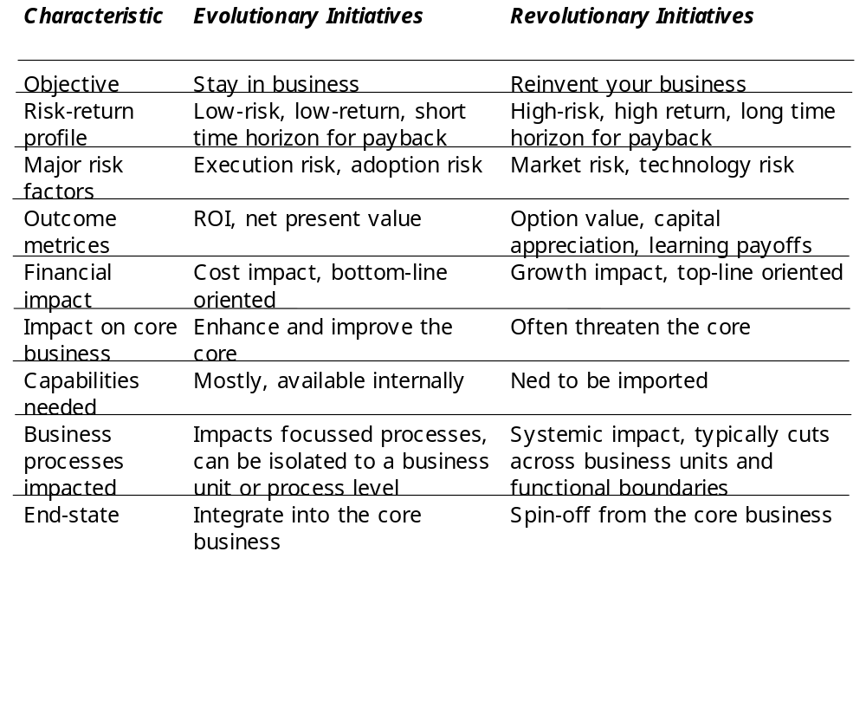
THE DUALITY OF E-BUSINESS INITIATIVES

Slide 28
DIMENSIONS OF THE BUSINESS ARCHITECTURE
Customers
(value proposition)
What we make
Products
Services
Information
What we know and own
Human capital
Structural capital
Relationship capital
Who we serve
Customer segments
Customer needs
Offerings
Resources
What we do
Realization process
Sourcing process
Operating processes
Go-to-market process
Growth
engine
How we make revenues
Customer leverage
Offering leverage
Market leverage
Top-line potential
Processes
Profit
engine
Partners
(value network)
Who we work with
Suppliers
Resellers
Complementors
How we make money
Sources of profits
Quality of profits
Defensibility of profits
Bottom-line potential

Slide 29
CORE PROCESSES
New offering realization process-how it defines, designs, and brings new offerings to market
Customer relationships management process-how it creates and builds relationships with its customers, and how it interacts with its customers
Fulfillment management process-how it sources its inputs and goes to market with its products and services
Human relations management process-how it attracts, grooms, and retains talent in the organization

Slide 30
CORE PROCESSES
Contd….
Market sensing process-hot it gathers intelligence from the market, disseminates this intelligence within the organization, and acts upon this information.
Operations management process-how it transforms its inputs into outputs
Business development process-how it renews its business and finds opportunities for growth.
Strategy development process-how it defines its end-goals, and the means for achieving the goals.
Partner management process-how it identifies, selects, coordinates with, and manages relationships with key partners and complementors
Financial management process-how it deploys its financial resources and allocates capital within the business.

Slide 31
SEVEN ORGANIZATIONAL PROCESSES IN E-BUSINESS TRANSFORMATION
Diffusing
Culture
Shared vision
Catalyzing
Incentives
Rewards
Motivating
Vision and
Strategy
Staffing
Training
Education
Mentoring
Traits
Skills
Structuring
External-
izing
Organization
Integration
Partners
Suppliers

Slide 32
STRATEGIC CONTROL ESSENTIAL
Traditional Approach ……………
To control compares actual results against standards
Strategic Control ……………
Tracking strategy as it is be implemented
Detecting problems or changes in its underlying premises/assumption and making adjustment
Guiding actions as its taking place

Slide 33
STRATEGIC CONTROL ESSENTIAL
2 sets of questions concerning successful of strategy…
Are we moving in the proper direction ? Are key things failing into place ? Are our assumptions about major trends and change correct ? Are we doing the critical things that need to be done ? Should we adjust or abort the strategy ?
How are we performing ? Are objectives and schedules being met ? Are costs, revenues and cash flows matching projections ? Do we need to make operational changes ?

Slide 34
ESTABLISH STRATEGIC CONTROL
Strategic Surveillance
Premise Control
Special Alert Control
Implementation Control
Strategy Formulation
Strategy Implementation
TIME 1
TIME 2
TIME 3

Slide 35
THE FOUR BASIC TYPES OF STRATEGIC CONTROL
Premise Control ……………
To check systematically and continuously whether the premises on which the strategy is based are still valid
Which premises should be controlled ?
Environmental Factors
Industry Factors
How are premises controls enacted ?

Slide 36
PREMISE CONTROL AT IBM
Applying Premise Control to build its future in “network-centric” direction
Old premise
Enter the internet

Slide 37
THE FOUR BASIC TYPES OF STRATEGIC CONTROL
Implementation Control ……………
To assess whether the overall strategy should be changed in the light of the results of associated with the incremental actions that implement the overall strategy
Monitoring strategic thrusts
Agree early in the planning process
Stop/go assessment
Milestones review

Slide 38
THE FOUR BASIC TYPES OF STRATEGIC CONTROL
Strategic Surveillance ……………
To monitor a broad range of events inside and outside the firm/organization that are likely to affect the course of its strategy

Slide 39
THE FOUR BASIC TYPES OF STRATEGIC CONTROL
Special Alert Control ……………
The thorough and often the rapid, reconsideration of the firm’s strategy because of a sudden, unexpected events

Slide 40
CHARACTERISTICS OF THE FOUR TYPES OF CONTROL
BASIC
PREMISES
IMPLEMENTATION
SURVEILLANCE
STRATEGIC ALERT
Object of
Control
Planning
premises and
Projections
Key strategic thrusts
And milestones
Potential threats
And opportunity
Related to strategy
Occurrence of
Recognizable but
Unlikely events
Degree of
Focusing
High
High
Low
High
Data acquisition :
Formalization
Centralization
Medium
High
Low
High
Low
Medium
Low
High
Use with :
Env Factors
Industry Factors
Strategic Spe
Company Spe
Yes
Seldom
Yes
Yes
Yes
Seldom
Yes
Yes
No
Yes
Seldom
Yes
No
Yes
Seldom
Seldom

Slide 41
OPERATIONAL CONTROL SYSTEMS
Guide, monitor and evaluate progress in meeting short term objectives.
While Strategic Control attempt to steer the company over an extended period (3 years more), Operational Control provide post action evaluation and control over short periods ( 1 mo to 1 yr)
4 steps common to all post action control :
Set standards of performance (KPI)
Measure actual performance
Identify deviations from standards set
Initiate corrective action

